Slide 1
ACOM and GHS
A unified model for personal health device communication
Supported on Bluetooth LE
Erik Moll
Philips Research
September 2022

Slide 2
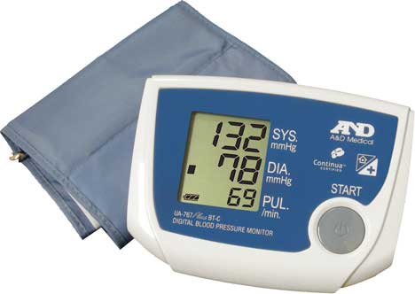





The problem
Personal health devices are abundantly available in most markets and are quite often connected and come with an application running on a smart phone, a tablet or sometimes a PC.
In most cases Bluetooth (Low Energy) is used to connect these devices. Sometimes USB, Wi-Fi or cellular connectivity is supported.
For remote patient monitoring, personal health & fitness tracking and many other use cases it is desired to integrate data from such devices in one place, one service for the patient or user.
Today, September 2022, there is still no good, generic, interoperable standard solution for personal health device communication.
As a result, for each PHD dedicated software is needed in devices, apps, gateways, servers => costly!
Proprietary Direct-to-Cloud (D2C) protocols
Personal Health Devices
Proprietary Direct-to-Cloud (D2C) protocols
Cloud-based
proprietary services
Cloud-based
proprietary services
Proprietary protocols over Bluetooth ®
Proprietary apps and gateways
Proprietary protocols over Bluetooth ®
Proprietary data upload and retrieval
Proprietary protocols over Bluetooth ®
Proprietary data upload and retrieval
Proprietary data upload and retrieval

Slide 3




The solution
HL7 FHIR:
The healthcare IT world is moving towards HL7 FHIR as the application-level language to achieve interoperability of healthcare data in and around the hospital.
Regulations in US and EU require healthcare IT systems to open up their data via a FHIR interface
This helps a lot but does not yet solve the PHD communication diversity and that is where ACOM comes into play.
IEEE 11073-10206 ACOM:
ACOM stands for “Abstract Content Model”
ACOM defines a model based on the IEEE 11073 Domain Information Model (DIM) and nomenclature standard for medical device communication
ACOM objects and attributes map 1-1 to HL7 FHIR resources using JSON or XML.
ACOM is implemented in a binary protocol on Bluetooth LE – the Generic Health Sensor profile and service (GHS).
ACOM can be used by cellular IoT health sensor devices using a binary or JSON format
Within various working groups of IEEE, IHE and the Bluetooth SIG we developed the ACOM specification and protocols using it.

Slide 4
The solution: ACOM + FHIR
Build once
ACOM + FHIR enable a generic solution to connect sensor devices to apps, gateways and to cloud services
Extendable / flexible solution
Sensor types can be added without coding in apps / gateways / servers
The set of supported Observations can be extended without coding
Many device types / specializations are defined already in IEEE 11073 in an ACOM-compatible manner
Enables an end-to-end ecosystem
Based on one conceptual model of health devices and generated observations using a recognized nomenclature system
Suitable for [personal] health sensor devices at home, in the hospital and elsewhere (health & fitness, elderly care)
Personal Health Devices
Direct-to-Cloud (D2C) ACOM/FHIR upload
FHIR servers
ACOM / GHS @ Bluetooth (LE)
Generic apps and gateways
IHE FHIR Observation upload and retrieval

Slide 5
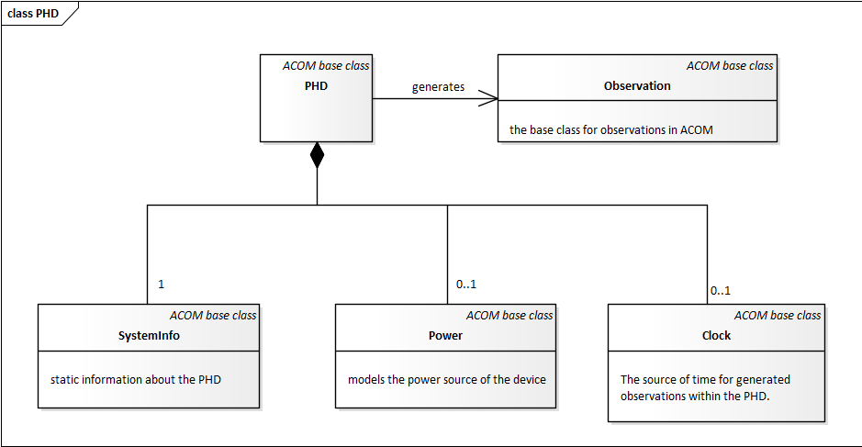
IEEE 11073-10206 - ACOM basics
ACOM defines a simple information model for PHDs

Slide 6
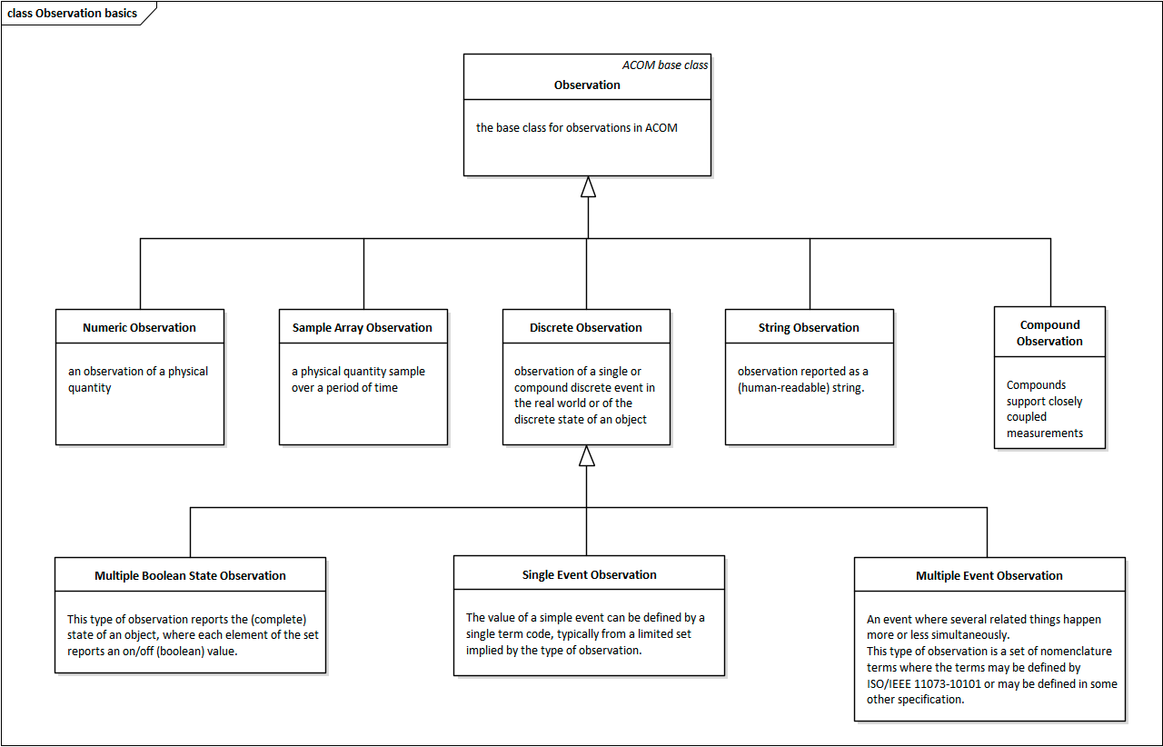
ACOM Observations
ACOM supports the common classes of observations from PHDs
ACOM is a toolbox to define observation profiles that your device type supports

Slide 7
ACOM Observation mapped to FHIR Observation resource
ACOM Observation attribute | Value | FHIR Observation attribute & value
Object | Numeric Observation | { “resourceType”: “Observation”,
Type | MDC_PULS_OXIM_SAT_O2 (2::19384) | “code”: {“coding”: [{ “system”: “urn:iso:std:iso:11073:10101”, “code”: “150456” }]},
Unit Code | MDC_DIM_PERCENT (4::544) | “valueQuantity”:{ “system”: “urn:iso:std:iso:11073:10101”, “code”: “262688”, “value”: 89.0 },
Observed Value | 89.0
Time stamp | 2017-09-04 16:30:00 +1:00 (1504542600) | “effectiveDateTime”: “2017-09-04T16:30:00+01:00” }
Example ACOM & FHIR SpO2 Observation
Mapping is following the HL7 FHIR PHD Implementation Guide and the IHE PHD Observation Upload (POU) profile

Slide 8
Bluetooth GHS GATT profile and service specifications
Generic Health Sensor Client / Collector
Observations
Device Information
Time
Power status
User Information
Generic Health Sensor Server / Sensor
Generic Health Sensor Service
GATT
Device Info Service 1.2
Elapsed Time Service
Battery Service 1.1
User Data Service 1.1
Connection parameters
Reconnection config 1.0
Simple to implement on constrained devices

Slide 9
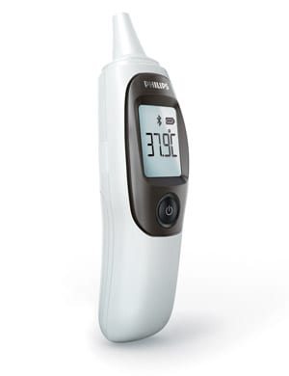
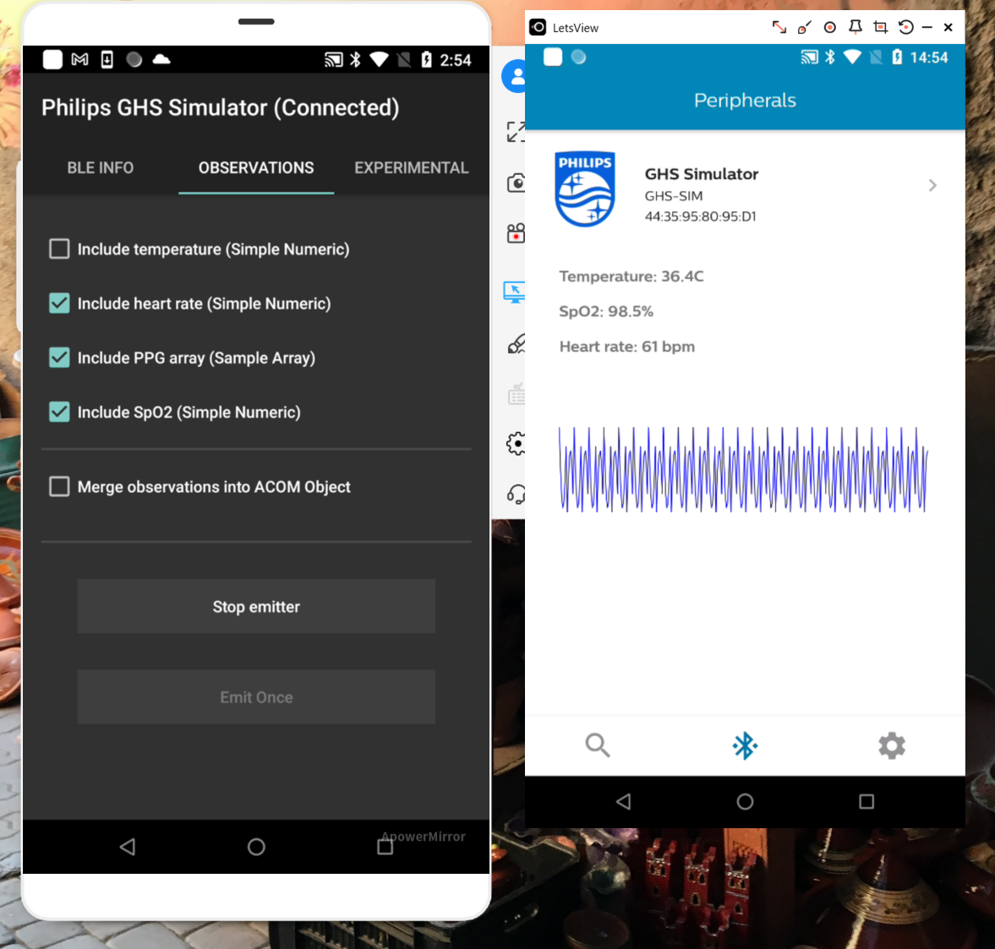



Philips ACOM/GHS prototypes – used for interop testing
Post Observations
LE / GATT / GHS
Health Observations
Device information
Time and power information
Open-sourced
https://github.com/philips-labs/BLE-GHS-Server-Simulator

Slide 10
Summary
We introduced the IEEE Abstract Content Model for Personal Health Devices – ACOM in the context of HL7 FHIR-based healthcare systems:
ACOM solves a big interoperability problem and enables an ecosystem of connected personal health devices, apps, services
The Bluetooth SIG Generic Health Sensor service and profile specification support ACOM on top of Bluetooth LE.
Some details:
IEEE 11073-10206 - ACOM defines a generic model for personal health devices and the observations these devices can generate
ACOM objects in this model can easily be mapped to FHIR resources
The Bluetooth Generic Health Sensor service and profile are based on ACOM and are in interop testing phase in the SIG
ACOM and GHS enable build-once gateways to get PHD Observations into FHIR servers
GHS demonstrators and source code are available on Android

